Slide 1
INTERACTIVE NOTBOOK topic: STATISTICS class: teacher: Semester 2, Term 3

Slide 2
24
7
30
Back to back Stem and leaf plots
WICOR
EQ – How do we create a back to back stem and leaf plot?
Write a summary from last lesson
A stem and leaf plot, arranges what type of data?
What is the median number of this data set
34, 36, 41, 46, 56, 58, 60, 66, 71
Name three types of triangles,
1
2
3
What is the range of the following data set
106, 222, 45, 314, 81, 133, 93, 154,

Slide 3
From previous Lessons
During the summer, Maddie plays a softball league. Her teams scores are
19, 15, 22
10, 37, 26
37, 12, 5
37, 19, 10
39, 16, 8
CREATE a stem and leaf plot
Mean? Median? Range?
0 | 5 8
1 | 0 0 2 5 6 9 9
2 | 2 6
3 | 7 7 7 9
20.8 19 34

Slide 4
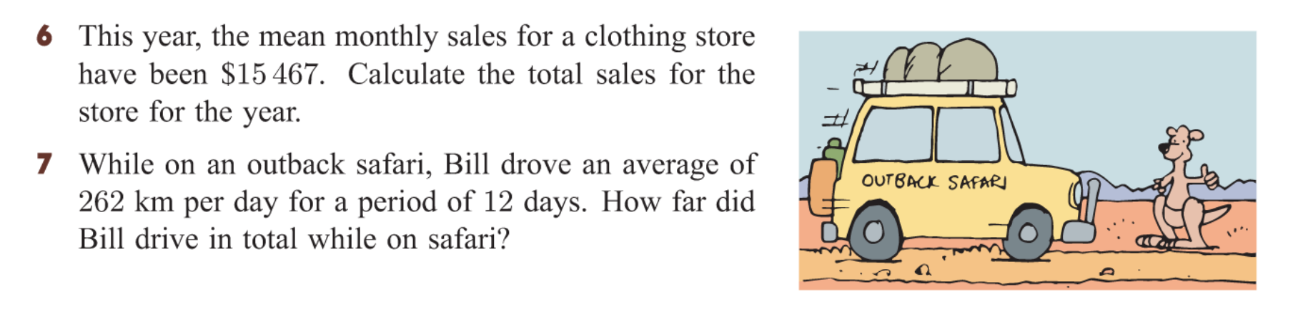


Slide 5
24
7
30
Back to back Stem and leaf plots
Date
EQ – How do we create a back to back stem and leaf plot?
Why do we use it?
To display two related data sets.
Example:
Mr Ships an Mr Chops class sat an exam (copy into books)
Mr Ship’s class |  | Mr Chop’s class
3 1 | 5 | 0 1 1 3 5 7
8 8 7 5 | 6 | 2 3 5 5 7 9 9
6 4 4 2 1 | 7 | 8 9 9
7 4 3 | 8 | 0 3
6 | 9 | 1

Slide 6
Hands up – stand up – pair up
In your teams of two can you WRITE THE QUESTION and answer them together.
5 questions altogether
10 minutes timer
Be prepared to share at the end!!

Slide 7
24
7
30
Back to back Stem and leaf plots
Date
EQ – How do we create a back to back stem and leaf plot?
Which class had the most students?
What were the lowest & highest scores from each class?
What were the median scores from each class?
Which class could be described as symmetrical and which is skewed?
Which class has the better results
Mr Ship’s class |  | Mr Chop’s class
3 1 | 5 | 0 1 1 3 5 7
8 8 7 5 | 6 | 2 3 5 5 7 9 9
6 4 4 2 1 | 7 | 8 9 9
7 4 3 | 8 | 0 3
6 | 9 | 1

Slide 8
Kahoot ☺
https://play.kahoot.it/#/k/99182d84-9b43-43fb-a1c9-15598f26f28e
No phone?
No worries…
Write the answers in your book

Slide 9
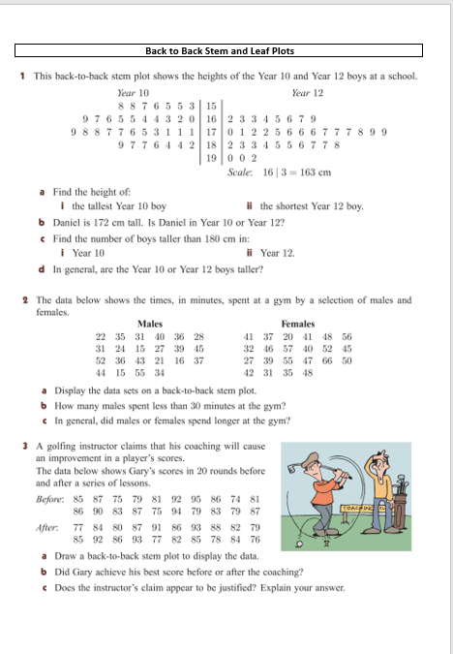
Task
Worksheet
(back to back) STEM AND LEAF PLOTS

